Slide 1
Immersion Day
AWS Systems Manager
Gain operational insights and take action

Slide 2
The pursuit of operational excellence
What resources make up my fleet?
Define the resources that represent your asset groups
Are my resources and applications healthy?
Visualize and track the state of your running applications.
How do I make sure they stay healthy?
Safely execute on-host, serverless, and cross-AWS-service actions.

Slide 3
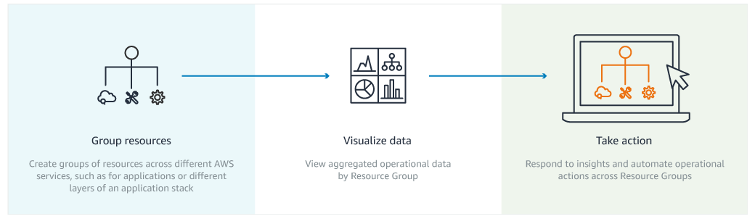
AWS Systems Manager
Gain operational insights and take action
AWS Systems Manager helps you shorten the mean time to detection and resolution of operational issues by allowing your to take reactive and proactive actions.

Slide 4
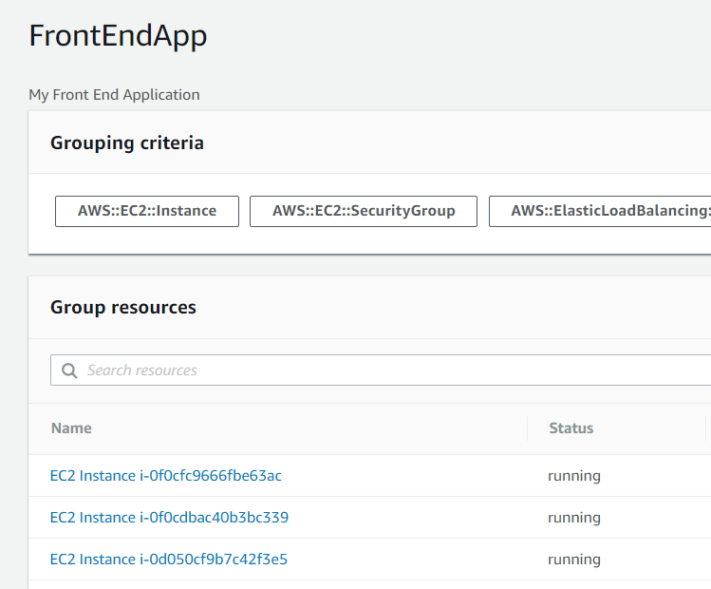
AWS Resource Groups – Group Resources
Define the building blocks of your fleets
AWS Resource Groups v2 just launched
Search AWS resources based on tags using a simple query
Save a search as a heterogeneous group of (dynamic) resources

Slide 5
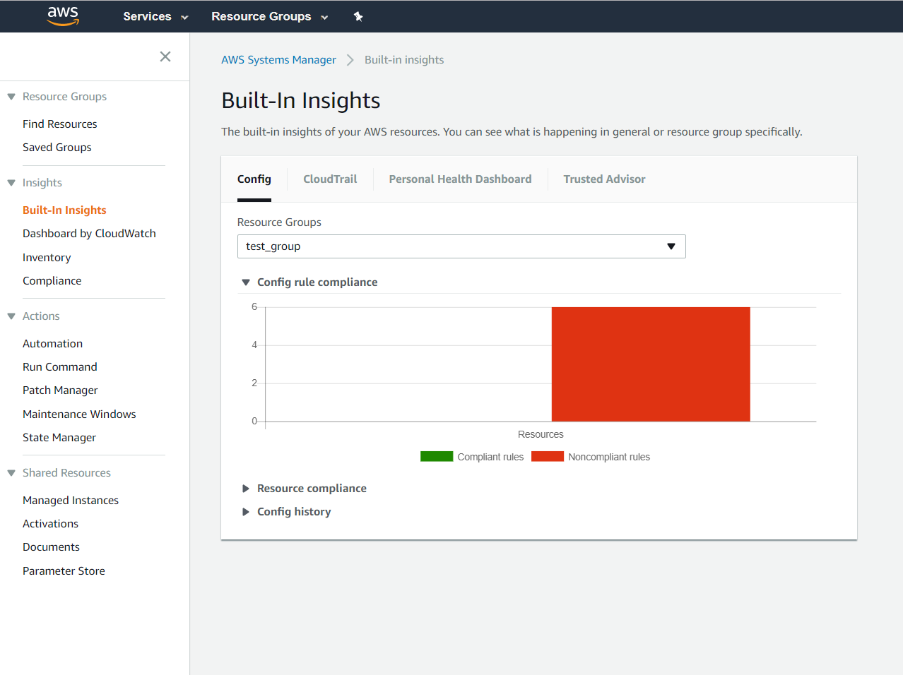
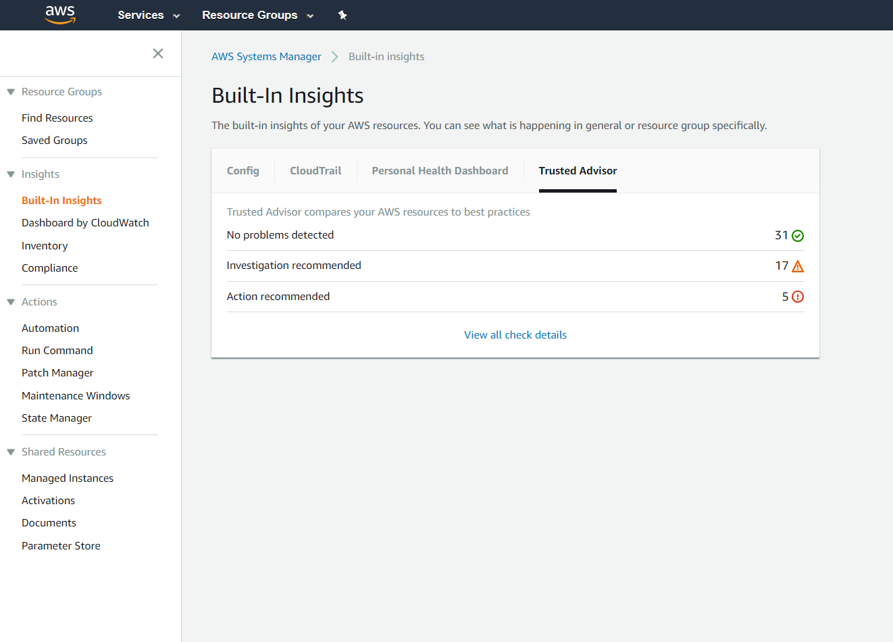
Built-In (cross-service) Insights
Gain operational insights
View recent API calls through AWS CloudTrail
View recent configuration changes through AWS Config
View recent events through AWS Personal Health Dashboard
View recommendations through AWS Trusted Advisor

Slide 6
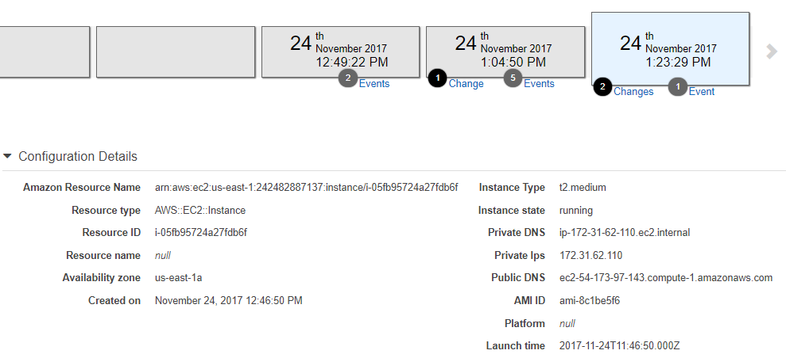
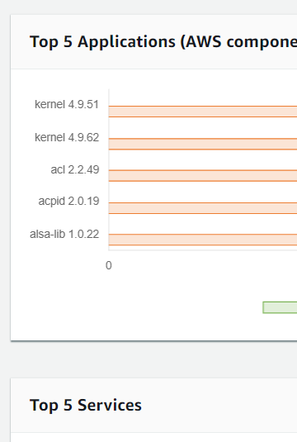
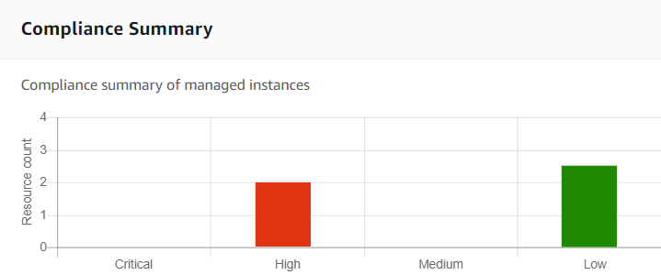
Track Software Inventory and Compliance
EC2 Instances and On-Premises Servers
Track and audit software inventory like application versions, and patches.
Track on-host configuration drifts like OS changes, files, folders, and permissions.

Slide 7
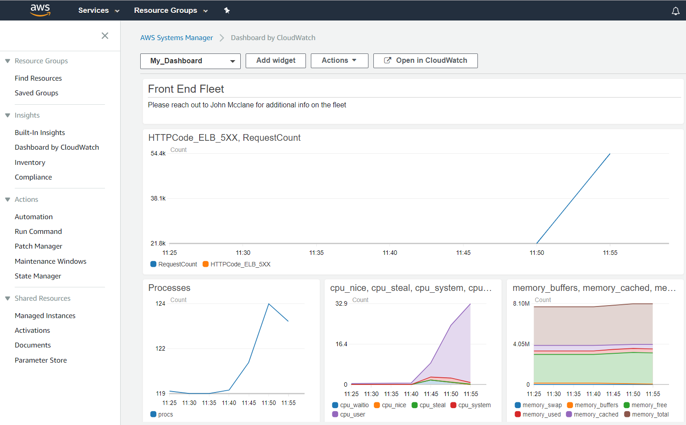
Build your own operational dashboards
Setup CloudWatch dashboards
Build your and customize your own ops-dashboards
Leverage your existing CloudWatch dashboards
Leverage your existing CloudWatch metrics
Visualize your application’s metrics

Slide 8
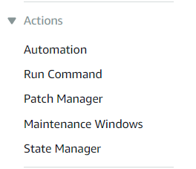
Reactive Action – Mitigate Issues Realtime
Reduce the mean time to resolution of operational issues
React from within the same console experience
Interact with Resource Groups directly
Trigger for automated responses
Reactive Action
Proactive Action
Notes:
Automation
Run command
Patch manager
Maintenance windows
State manager

Slide 9
Proactive Action - Day to Day Operations
Execute commands on any instance or on-premises host
Manage your configuration to mitigate drifts
Setup maintenance windows for common operations
Manage software patches across your fleets
Store your secrets and configuration data
Reactive Action
Proactive Action

Slide 10
Automation
Use AWS vetted documents or create your own
Use community generated documents
Automate repeatable manual tasks
Trigger documents based on changes to resources
CloudWatch Events or Maintenance Windows as a trigger
Execute one step at a time
Delegated execution to authorized users only
Perform bulk operations with built-in safeties
Velocity controls and error thresholds
Run documents on resource groups, tags, or Instance IDs
Reactive Action
Proactive Action
Notes:
Apply automation to both reactive/proactive scenarios

Slide 11






New AWS Services to support Fleet Management
Run Command
Maintenance Window
Inventory
State Manager
Patch Manager
Parameter Store

Slide 12
Lab Exercises

Slide 13

AWS Systems Manager Components
Group
Resource Groups
Visualize
Inventory
Compliance
Take Action
Automation
Run Command
Session Manager
Patch Manager
Maintenance Windows
State Manager

Slide 14
AWS Systems Manager Resource Groups
A resource group is a collection of AWS resources that are all in the same AWS region, and that match criteria provided in a query.
You build queries in the Resource Groups console, or pass them as arguments to Resource Groups commands in the AWS CLI.
With Resource Groups, you can create a custom console that organizes and consolidates information based on criteria that you specify in tags.
After you've created groups in Resource Groups, use AWS Systems Manager tools such as Automation to simplify management tasks on your groups of resources.
You can also use groups as the basis for viewing monitoring and configuration insights in Systems Manager.

Slide 15
AWS Systems Manager Resource Groups
How to Organize Them?
Common groupings:
By type of environment: development, staging, production
By department resources apply to: HR, Finance, Marketing
By project area: eCommerce, Business Intelligence
By version of an architecture: legacy, current, experimental, cloud-native
By architecture component type: databases, storage, compute, networking
By geography: US Region, EMEA, APAC, Northwest, Midwest
By who it services: internal applications vs. customer-facing applications
By Maintenance Group
By development environments: Java, .NET,

Slide 16
SSM Inventory Manager
You can use AWS Systems Manager Inventory to collect multiple types of metadata from your Amazon EC2 instances and your on-premises servers or virtual machines (VMs) in your hybrid environment.
O/S
Instance
Information
Application
Information
Network Config
Windows
Registry
AWS
Components
Custom
Inventory
File Information
You can query the metadata to quickly understand which instances are running the software and configurations required by your software policy, and which instances need to be updated.

Slide 17
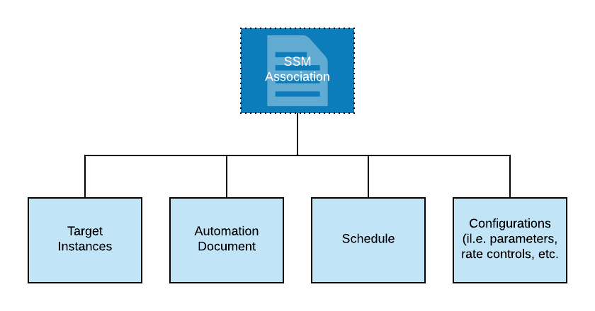
SSM Inventory Manager
How it Works
When you configure Systems Manager Inventory, you specify:
The type of metadata to collect
The instances from where the metadata should be collected
The schedule for metadata collection.
Together, those elements form a type of configuration, called an Association, that can be used to gain insights or perform actions.
Associations are used in many SSM modules (i.e. Inventory and Maintenance Windows)

Slide 18
SSM Inventory Manager
Things to Remember about Inventory Associations
You can create multiple inventory associations
You can easily inventory all managed instances in your AWS account by creating a global inventory association.
A global inventory association performs the following actions:
Automatically applies the global inventory configuration to all existing managed instances in your AWS account.
Automatically adds new instances created in your AWS account to the global inventory.
Skips instances that already have an inventory association (with the detailed status message states Overridden By Explicit Inventory Association)
If an instance is configured for the global inventory association, and you assign a specific association to that instance, then Systems Manager Inventory deprioritizes the global association and applies the specific association.

Slide 19
SSM Automation
Systems Manager Automation simplifies common maintenance and deployment tasks of Amazon EC2 instances and other AWS resources.
Automation enables you to do the following.
Build Automation workflows to configure and manage instances and AWS resources.
Create custom workflows or use pre-defined workflows maintained by AWS.
Receive notifications about Automation tasks and workflows by using Amazon CloudWatch Events.
Monitor Automation progress and execution details by using the Amazon EC2 or the AWS Systems Manager console.
Support manual approval gates within an automation.

Slide 20
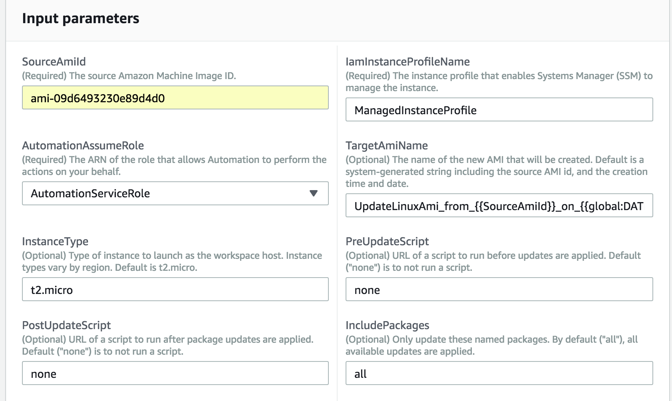
SSM Automation
Some automations require elevated privileges

Slide 21
SSM Run Command
AWS Systems Manager Run Command lets you remotely and securely manage the configuration of your managed instances. A managed instance is any Amazon EC2 instance or on-premises machine in your hybrid environment that has been configured for Systems Manager. Run Command enables you to automate common administrative tasks and perform ad hoc configuration changes at scale.
You can use Run Command from the AWS console, the AWS Command Line Interface, AWS Tools for Windows PowerShell, or the AWS SDKs.
Administrators use Run Command to perform the following types of tasks on their managed instances:
install or bootstrap applications
build a deployment pipeline,
capture log files when an instance is terminated from an Auto Scaling group
join instances to a Windows domain

Slide 22
SSM Session Manager
Session Manager is a fully managed AWS Systems Manager capability that lets you manage your Amazon EC2 instances through an interactive, one-click, browser-based shell.

Slide 23
SSM Session Manager
Session Manager offers these benefits:
Centralized access control to instances using IAM policies. Administrators have a single place to grant and revoke access to instances.
No open inbound ports and no need to manage bastion hosts or SSH keys. Session Manager helps you improve your security posture by letting you close these inbound ports, freeing you from managing SSH keys and certificates, bastion hosts, and jump boxes.
One-click access to instances from the console and CLI.
Cross-platform support for both Windows and Linux. Session Manager provides both Windows and Linux support from a single tool. For example, you don't need to use an SSH client for Linux instances and an RDP connection for Windows instances.
Logging and auditing session activity. Logs a full record of the connections made to your instances and the commands that were run on them. You can also receive notifications when a user in your organization starts or ends session activity.

Slide 24
SSM Patch Manager
AWS SSM Patch Manager automates the process of patching managed instances with security-related updates (for Linux-based instances, you can also install patches for non-security updates). You can patch fleets of Amazon EC2 instances or your on-premises servers and virtual machines (VMs) by operating system type.
You can scan instances to see only a report of missing patches, or you can scan and automatically install all missing patches.
Patch Manager uses patch baselines, which include rules for auto-approving patches within days of their release, as well as a list of approved and rejected patches. You can install patches on a regular basis by scheduling patching to run as a Systems Manager Maintenance Window task. You can also install patches individually or to large groups of instances by using Amazon EC2 tags.
Important: AWS does not test patches for Windows or Linux before making them available in Patch Manager.

Slide 25
SSM Patch Manager
Organize Instances into Patch Groups
A patch group is an optional means of organizing instances for patching. For example, you can create patch groups for different operating systems (Linux or Windows), different environments (Development, Test, and Production), or different server functions (web servers, file servers, databases).
Patch groups can help you avoid deploying patches to the wrong set of instances. They can also help you avoid deploying patches before they have been adequately tested.
You create a patch group by using Amazon EC2 tags. Unlike other tagging scenarios across Systems Manager, a patch group must be defined with the tag key: Patch Group. Note that the key is case sensitive. You can specify any value, for example "web servers," but the key must be Patch Group.
Note: An instance can only be in one patch group.

Slide 26
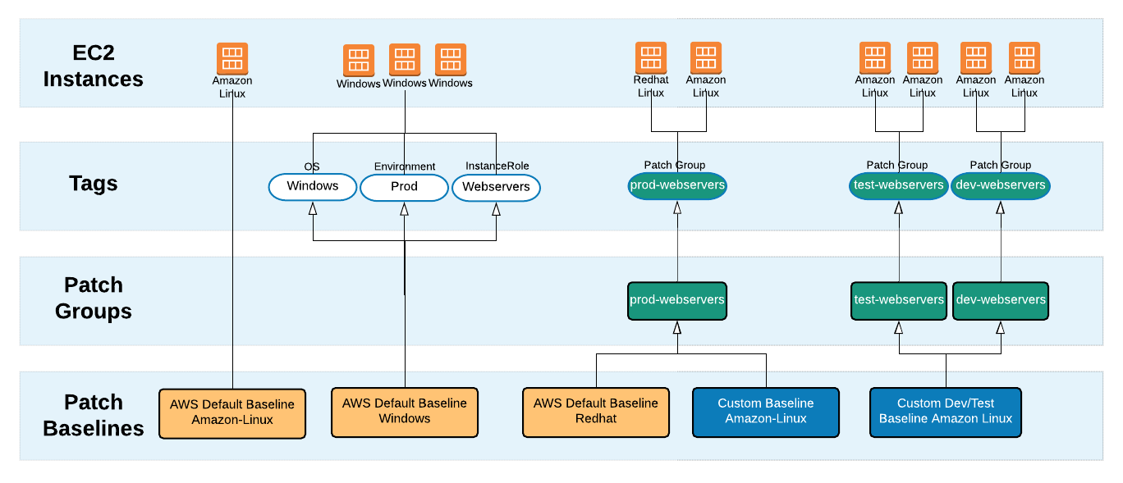
SSM Patch Manager – Baseline Associations

Slide 27
SSM Patch Manager
Patching Process
When the system runs the task to apply a patch baseline to an instance, the service checks to see if a patch group is defined for the instance.
If the instance is assigned to a patch group, the system then checks to see which patch baseline is registered to that group.
If a patch baseline is found for that group, the system applies the patch baseline. If an instance isn't configured for a patch group, the system automatically uses the currently configured default patch baseline.

Slide 28
SSM Maintenance Windows
Maintenance Windows let you define a schedule for performing potentially disruptive actions on your instances.
Each Maintenance Window has a schedule, a duration, a set of registered targets, and a set of registered tasks, such as the following:
Install or update applications.
Apply patches.
Install or update the SSM Agent.
Run PowerShell commands and Linux shell scripts by using a Systems Manager Run Command task.
Build Amazon Machine Images (AMIs), boot-strap software, and configure instances by using Systems Manager Automation.
Run AWS Lambda functions that trigger additional actions, such as scanning your instances for patch updates.
Run AWS Step Function state machines to perform tasks such as removing an instance from an Elastic Load Balancing environment, patching the instance, and then adding the instance back to the Elastic Load Balancing environment.

Slide 29
SSM Maintenance Windows
When you configure the task, you have two options:
1 - Scan Only | 2 - Scan and Install
scans each instance generates a list of missing patches for you to review | scans each instance compares against baseline downloads and installs all missing and approved patches
Important
After installing patches, Systems Manager reboots each instance. The reboot is required to make sure that patches are installed correctly and to ensure that the system did not leave the instance in a potentially bad state.

Slide 30
SSM Documents

Slide 31
SSM Documents
Creating Composite Documents
A composite SSM document is a custom document that performs a series of actions by running one or more secondary SSM documents. Composite documents promote infrastructure as code by enabling you to create a standard set of SSM documents for common tasks such as boot-strapping software or domain-joining instances. You can then share these documents across AWS accounts to reduce SSM document maintenance and ensure consistency.
For example, you can create a composite document that performs the following actions:
Updates SSM Agent to the latest version.
Installs all whitelisted patches.
Installs antivirus software.
Downloads scripts from GitHub and runs them.

Slide 32
SSM State Manager
AWS Systems Manager State Manager is a secure and scalable configuration management service that automates the process of keeping your Amazon EC2 and hybrid infrastructure in a state that you define.
Some of the tasks you can automate using State Manager, to run on schedules you specify, include:
Bootstrap instances with specific software at start-up
Download and update agents on a defined schedule, including SSM Agent
Configure network settings
Join instances to a Windows domain (Windows instances only)
Patch instances with software updates throughout their lifecycle
Run scripts on Linux and Windows managed instances throughout their lifecycle
Eliminate Drift

Slide 33
SSM Configuration Compliance
You can use AWS Systems Manager Configuration Compliance to scan your fleet of managed instances for patch compliance and configuration inconsistencies. You can collect and aggregate data from multiple AWS accounts and Regions, and then drill down into specific resources that aren’t compliant.
Systems Manager Compliance offers the following additional benefits and features:
View compliance history and change tracking for Patch Manager patching data and State Manager associations by using AWS Config.
Customize Systems Manager Compliance to create your own compliance types based on your IT or business requirements.
Remediate issues by using Systems Manager Run Command, State Manager, or Amazon CloudWatch Events.
Port data to Amazon Athena and Amazon QuickSight to generate fleet-wide reports.

Slide 34
Create a Resource Data Sync for Configuration Compliance
The following graphic shows how Resource Data Sync aggregates all data from different accounts, Regions, and hybrid environments to a central repository.

Slide 35
Next Steps:
Define grouping strategy
Setup inventory
Setup resource sync
Setup patch baselines
Setup maintenance windows (automations, targets, schedules)
Define reporting needs

Slide 36
Group: cloud-ops-group
Group policy: custom-ssm-cloud
Users: cloud-ops-1, cloud-ops-2, cloud-ops-3
Instance role: custom-managed-instance-role-SSM
Resources:
Complete series of SSM overviews/tutorials, on Youtube here
Github repo with SSM Immersion day sample code here
X
X
X

